Slide 1

Three-Dimensional Magnetic and Velocity Structures of Active Region 12673
Haimin Wang, Bin Chen, Ju Jing, Sijie Yu, Chang Liu, Vasyl Yurchyshyn, Kwangsu Ahn, Takenori Okamoto, Shin Toriumi, Wenda Cao, Dale Gary

Slide 2
Very Unusual AR 12673, many studies on Sept. 6, 2017 X9.3 flare
Strong Shear Flow and Sunspot Rotation---Romano et al., 2018, ApJL, 852, L10, Verma, 2018, A&A, 612, 101; Yan et al., 2018, ApJ. 856, 79
Strong flux emergence and helicity injection—Sun and Norton, 2017, RNAAS, 1, 24, Vemareddy, 2019, ApJ, 872, 182
Interaction between new flux and existing spot; fluxrope build up: Yang et al., 2017, ApJL, 849, L21; Liu et al., 2018, ApJL, 865, L5; Bamba et al., 2020, ApJ, 894, 29; Zou et al., 2020, ApJ, 890, 10
MHD Modeling, Jiang et al. 2018, Ap.J. 869, 13; Inoue et al, 2018, ApJ., 867, 831
Weak SEP , largest WL emission, Huang et al., 2018, RNAAS, 2,7
Strong Transverse Fields (>5000G), Wang et al., 2018, RNAAS, 2, 8, (>2000G in corona) Anfinogentov et al., 2019, ApJL, 880, L29

Slide 3
Our Objectives
Uniquely combined observations of GST, EOVSA, Hinode and SDO, as well as NLFFF extrapolation tools to understand 3-D magnetic, velocity and thermal structure of this active region; offer possible explanation of formation of unusually strong fields and complex magnetic structure.

Slide 4
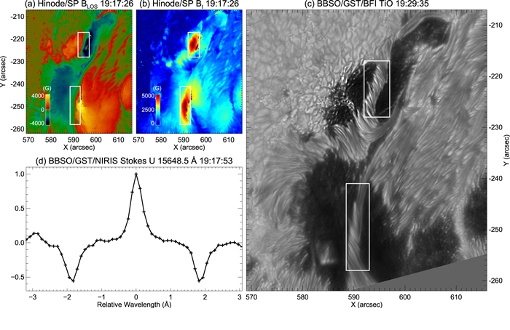
Figure 1 from Strong Transverse Photosphere Magnetic Fields and Twist in Light Bridge Dividing Delta Sunspot of Active Region 12673
Haimin Wang et al. 2018 Res. Notes AAS 2 8 doi:10.3847/2515-5172/aaa670

Slide 5
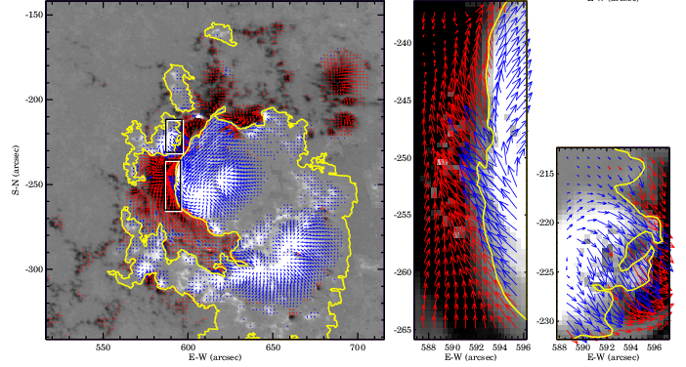
Strong Sheared Field Lines at PIL

Slide 6
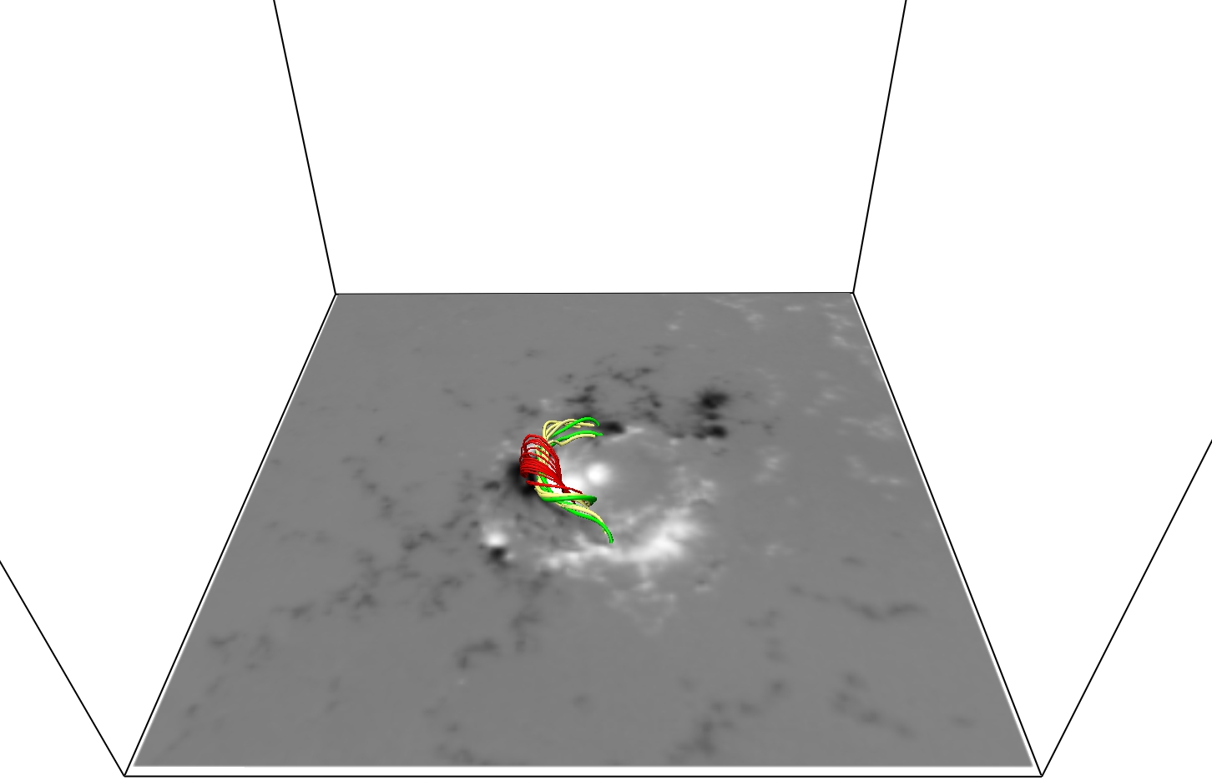
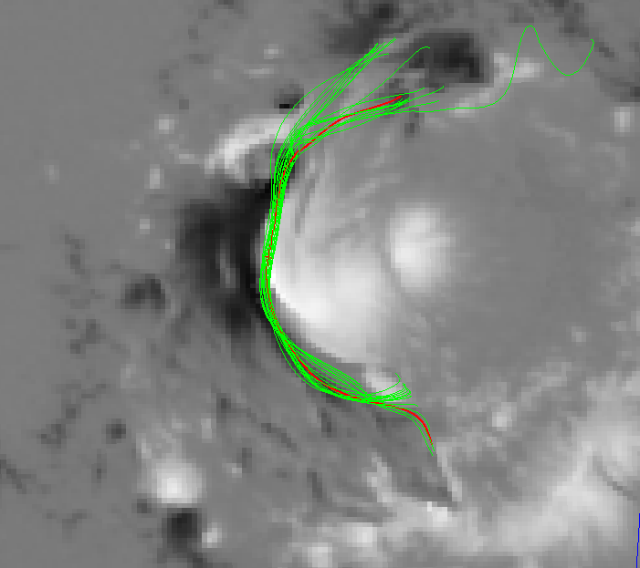
Flux Ropes found from NLFFF, very close to photospheric surface

Slide 7
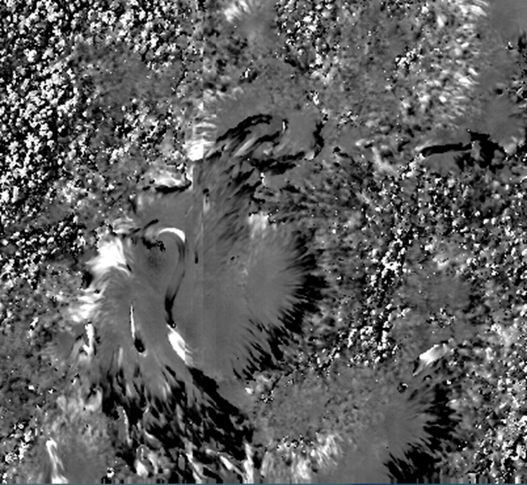
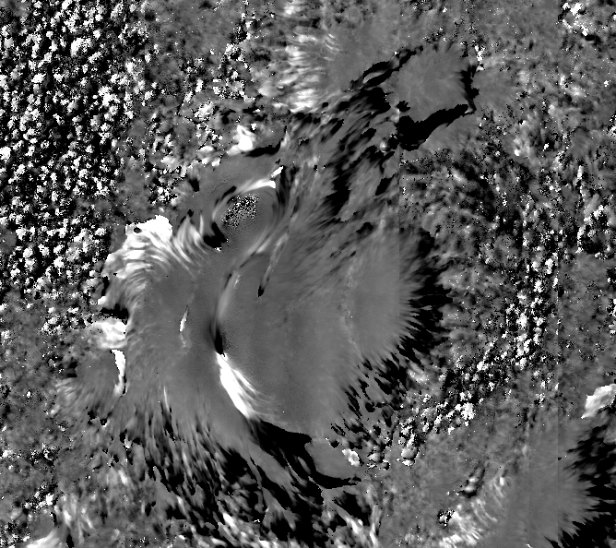

Doppler Maps of 09/06/17 (upflow at PIL marked by arrow)
0614UT 1208UT

Slide 8
The previous sides are Hinode SP observations. The following slide plots the line of sight velocity along PIL. The upflow (4km/s) on the center is followed by doenflow at two ends

Slide 9
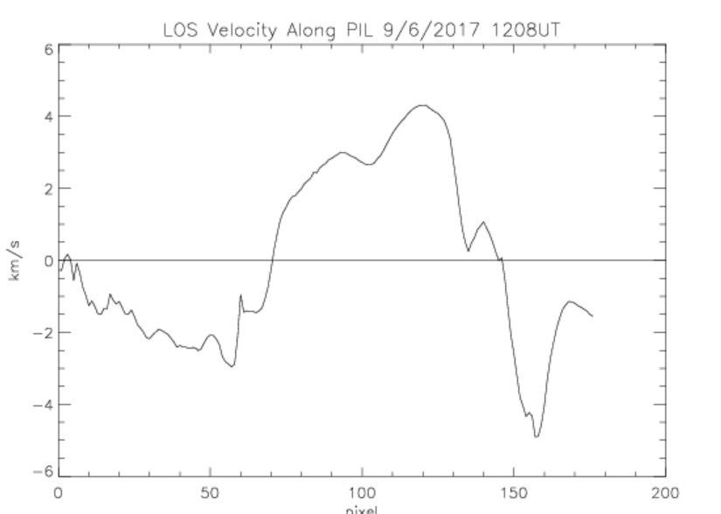

Slide 10
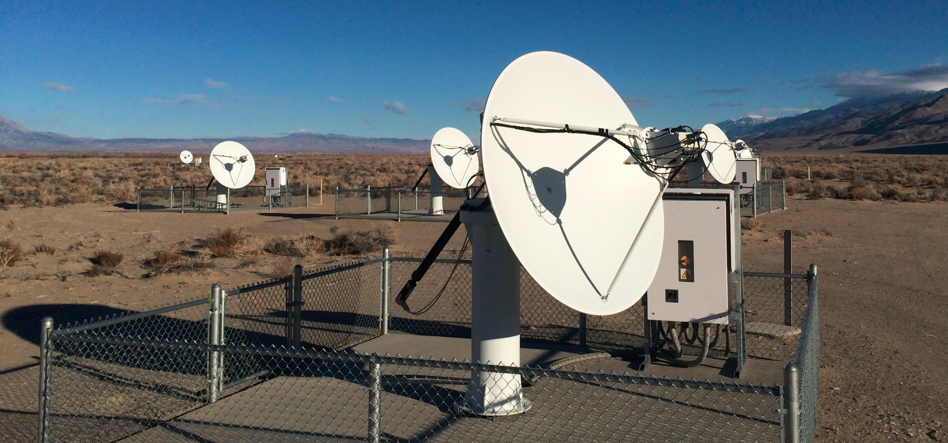
Expanded Owens Valley Solar Array
13-antenna interferometer array operating over frequency range 1-18 GHz
Provides dynamic (1 s) “imaging spectroscopy” (>100 frequencies)

Slide 11
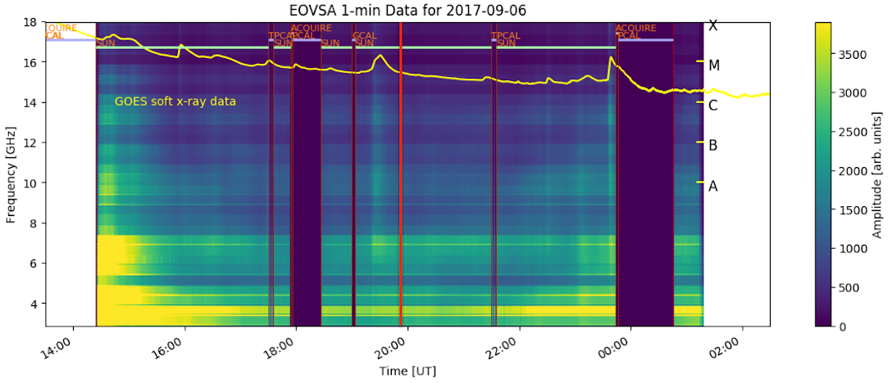

Slide 12
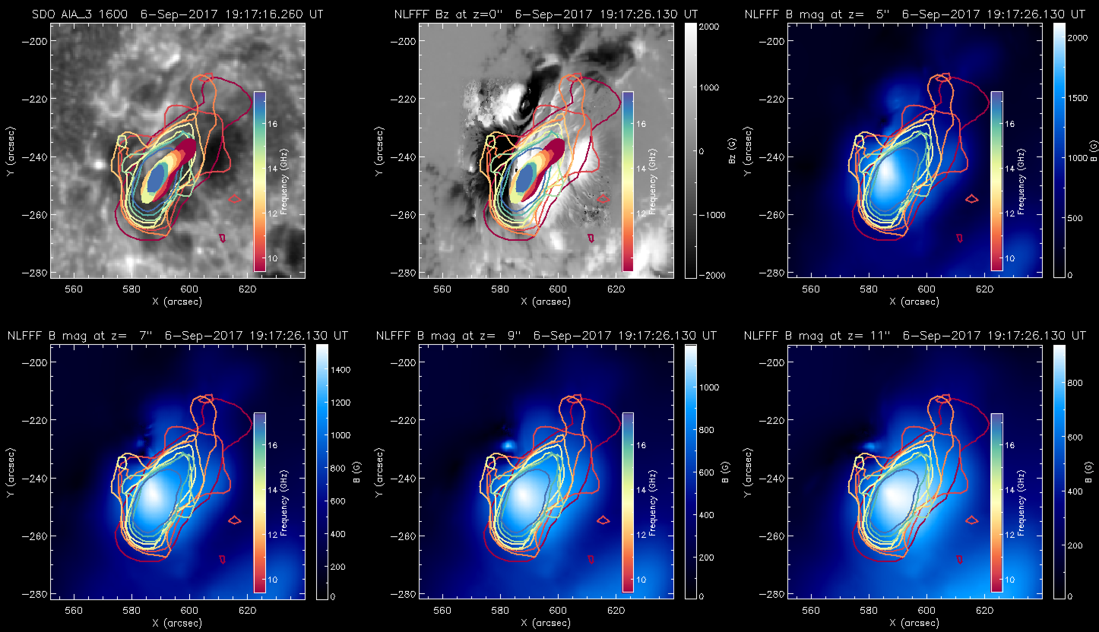
Microwave Contours Compared with AIA and NLFFF B at Diff. Heights

Slide 13
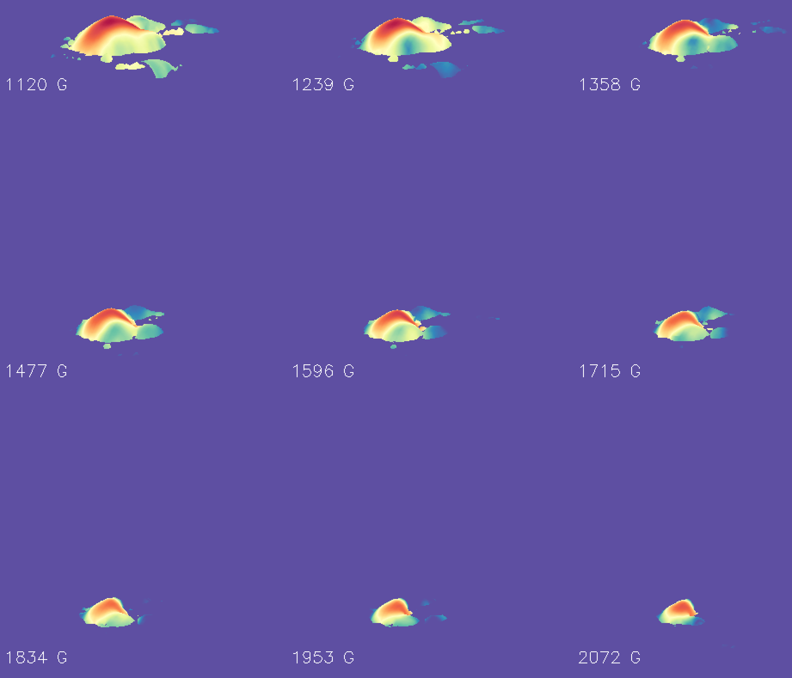
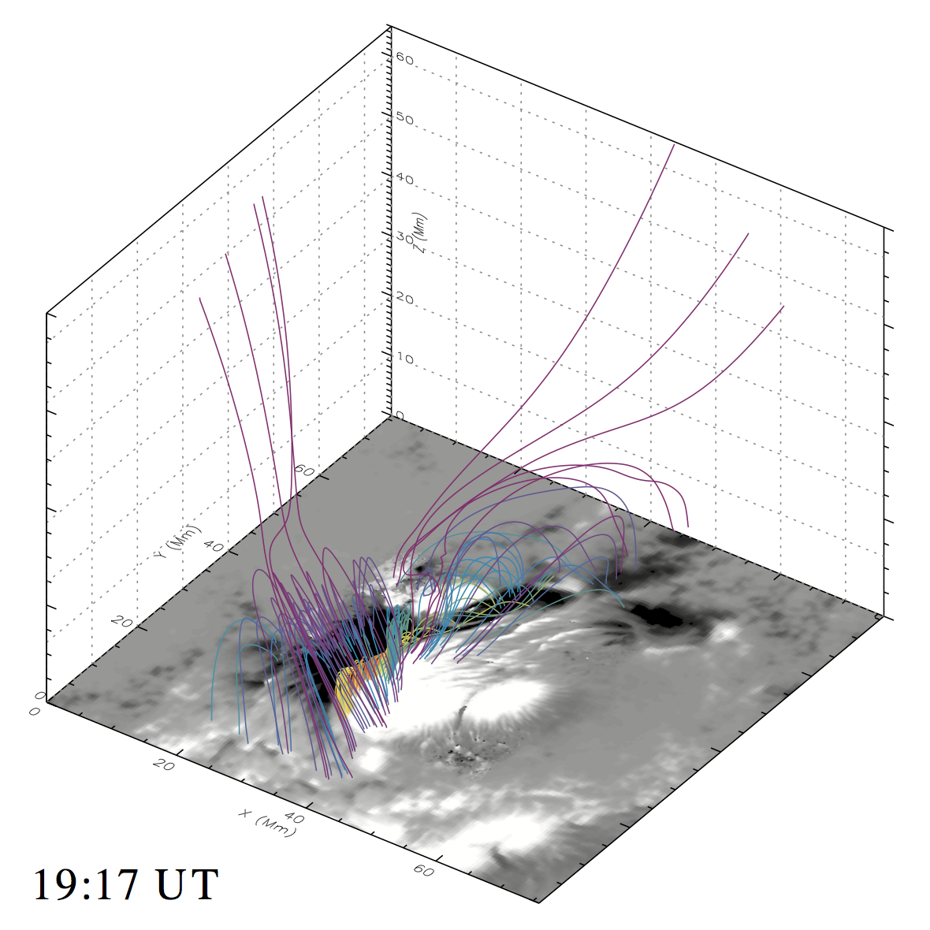
Compare to extrapolations: The high temperature “arcade” corresponds to the hot/heated magnetic flux rope or highly sheared arcade.

Slide 14
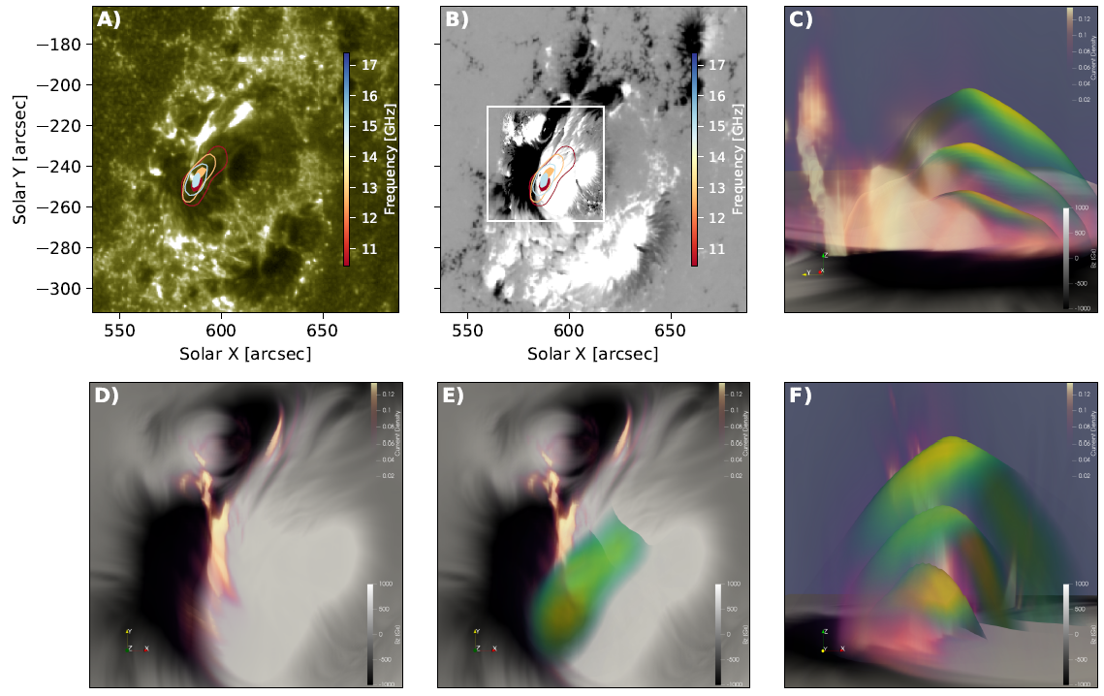
3D current density and the microwave maps, emission frequency of 10.4, 13.4 and 17.4 GHz or B field strength 1239.5, 1596.7, 2072.9 Gs, D and E: current density, C and F: 3D view of the microwave Tb painted in the isogauss layers

Slide 15
Summary
1. Strong flux emerging, strong collisional motion, shear motion all contribute to energy build-up of AR 12673 in September 2017.
2. Nearly 6000 G field are found at flaring PIL. 1000G to 2000G fields are found between 8Mm to 4Mm in corona.
3. Strong high frequency microwave emissions are found at flaring PIL, corresponding to fluxrope.
4. Flux rope may exist at and below photospheric level, rising up. Rising flow velocity can reach 4 km/s at the center of PIL. Downflows are found at two ends.
5. Formation of strong fields, high sheared flux rope are associated with both apparent shear and collision motions. These may be the signature of rising twisted flux system from sub-surface.

