Slide 1

Solar Radio Monitoring for Space Weather Applications
Peter T. Gallagher

Slide 2
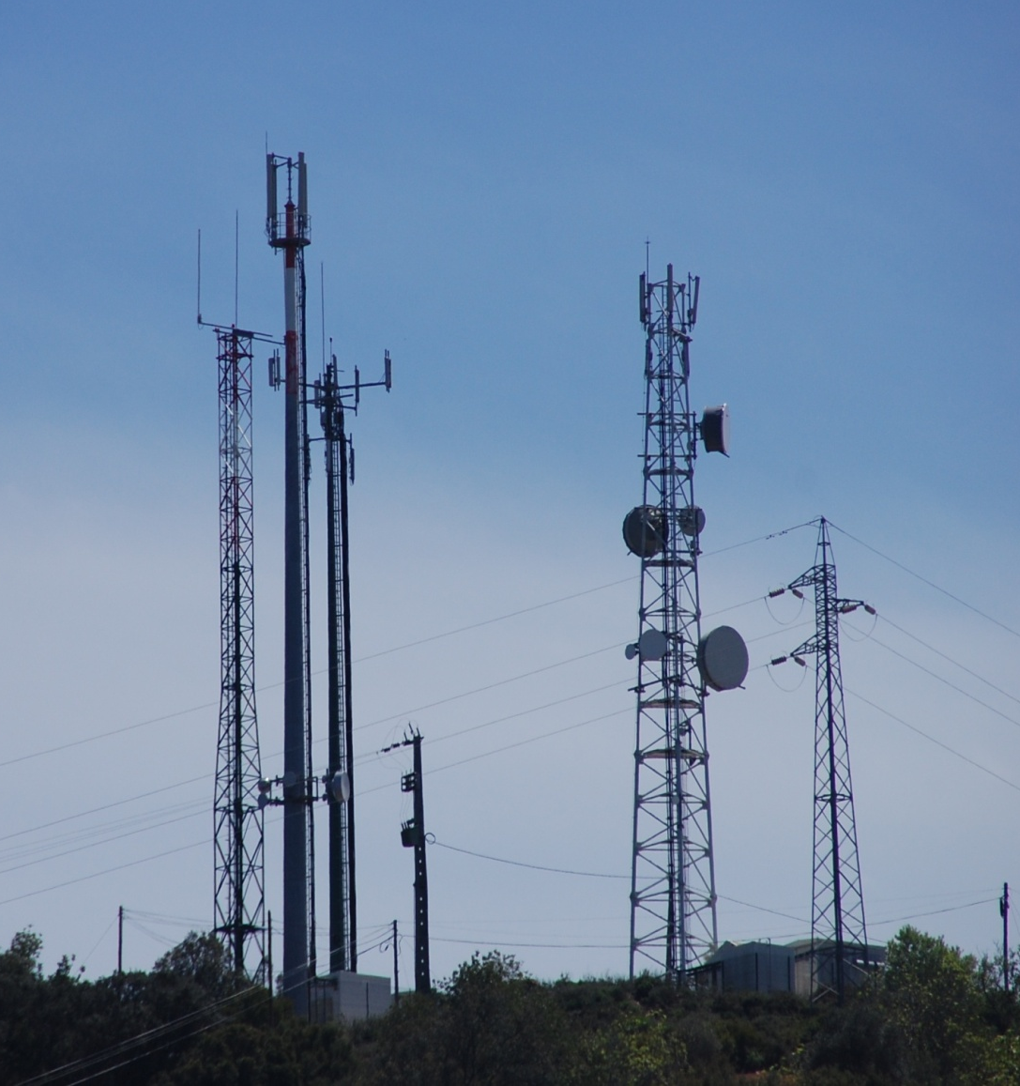
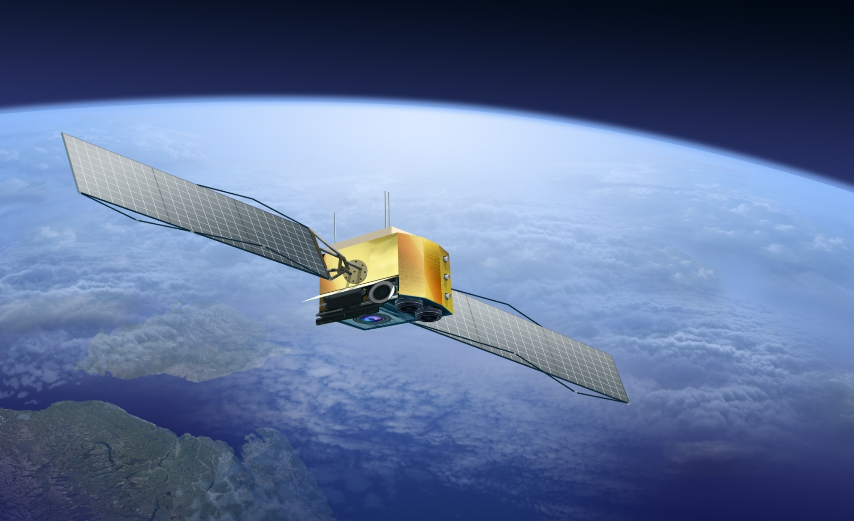

Space Weather Effects of Solar Radio Emission
Dropped calls on mobile phone networks.
Air traffic control interference (e.g., Sweden).
Radar interruptions.
Short wave/high frequency communication fades.
GNSS/GPS signal disruption.
Satellite communications interruptions.

Slide 3
Solar Radio and Space Weather
Coronal holes
  Low radio fluxes
  Solar wind streams
Active regions
  Noise storms
  Coronal magnetic fields
  Brightness temperatures
Energetic particles
  Type IIs and Type IIIs
Coronal mass ejections
  Bulk plasma motion
  Shocks
  Solar wind prediction
  @1 AU
  Flare/CME forecasting
  Shock/particle prediction
  @ 1AU
  CME prediction
  @ 1AU

Slide 4
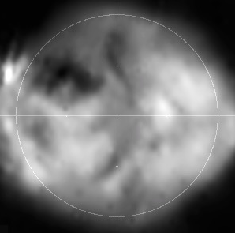
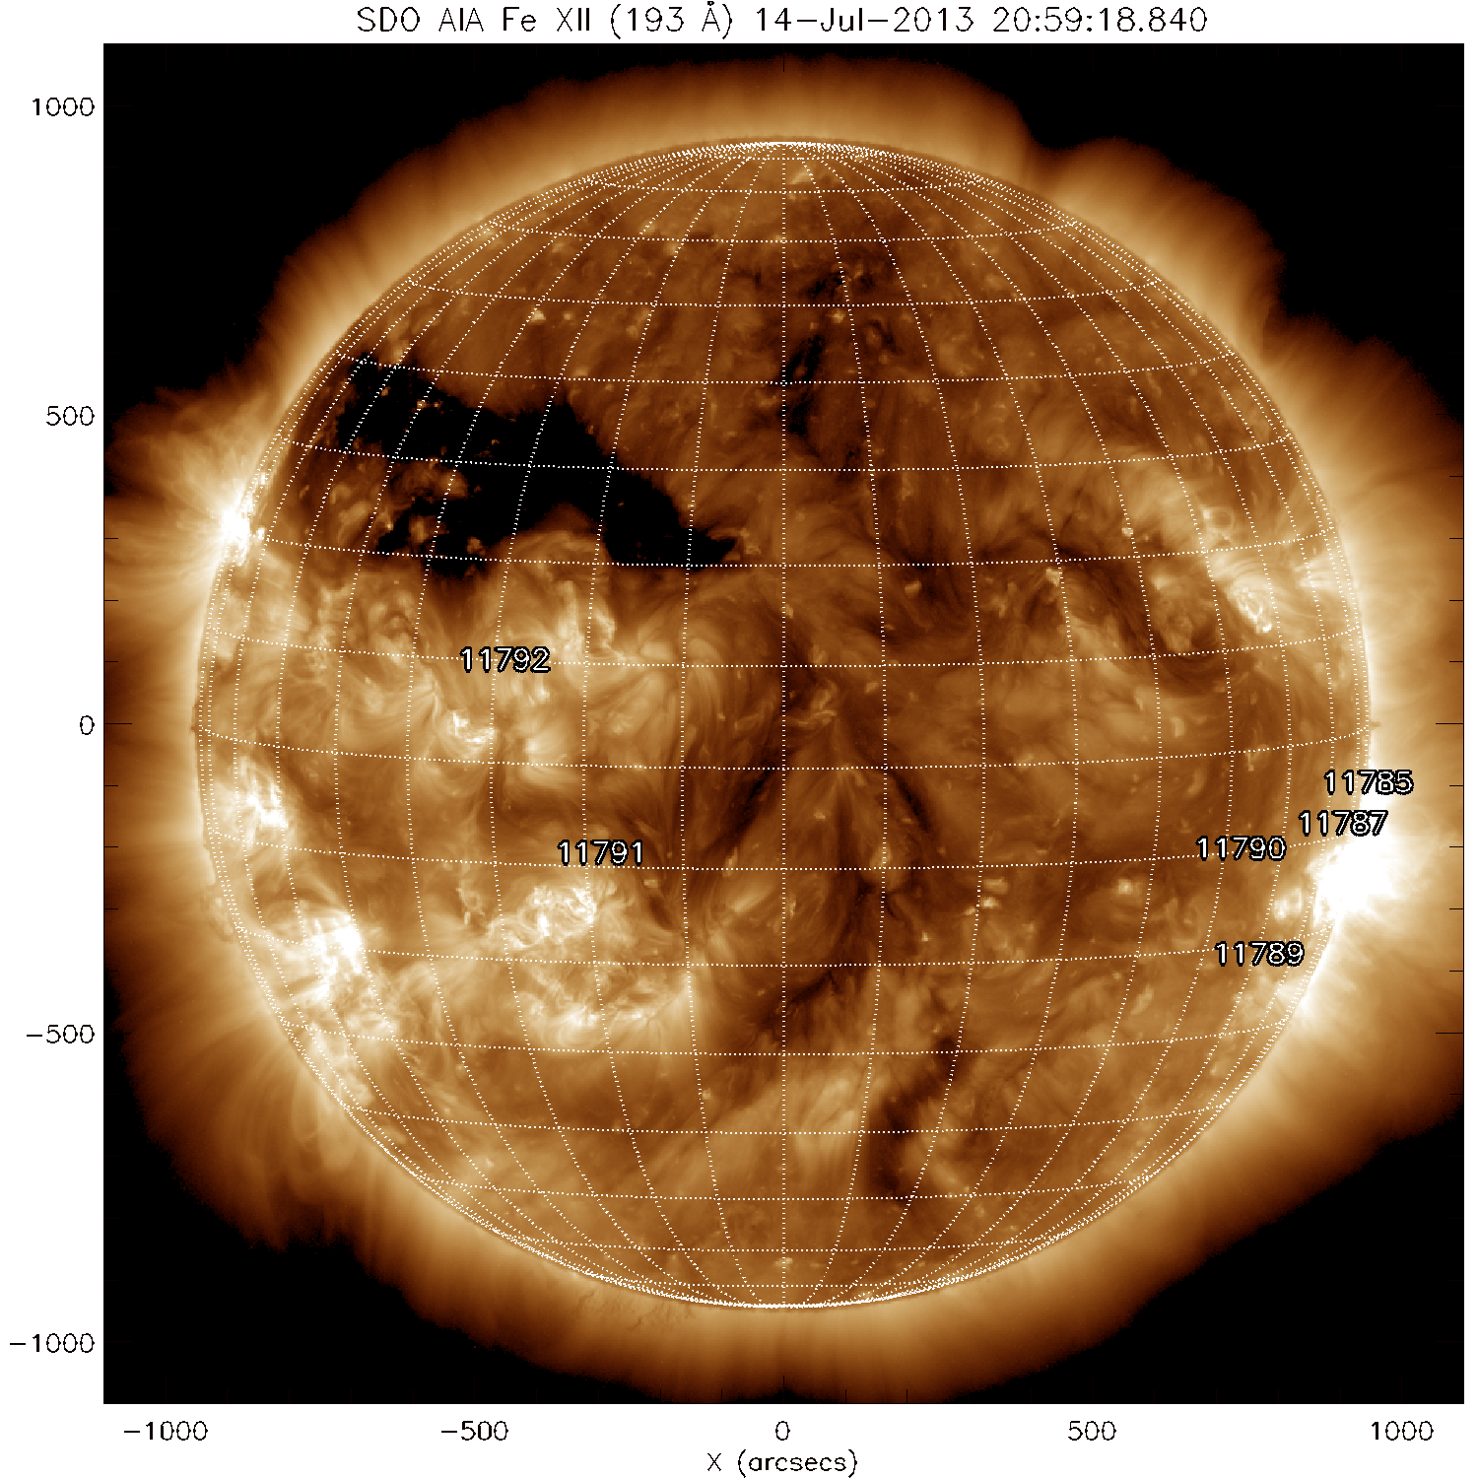
Coronal Holes
Nancay Radioheliograph (432 MHz) SDO/AIA 193 A
14 July 2013
Coronal Holes
solarmonitor.org

Slide 5
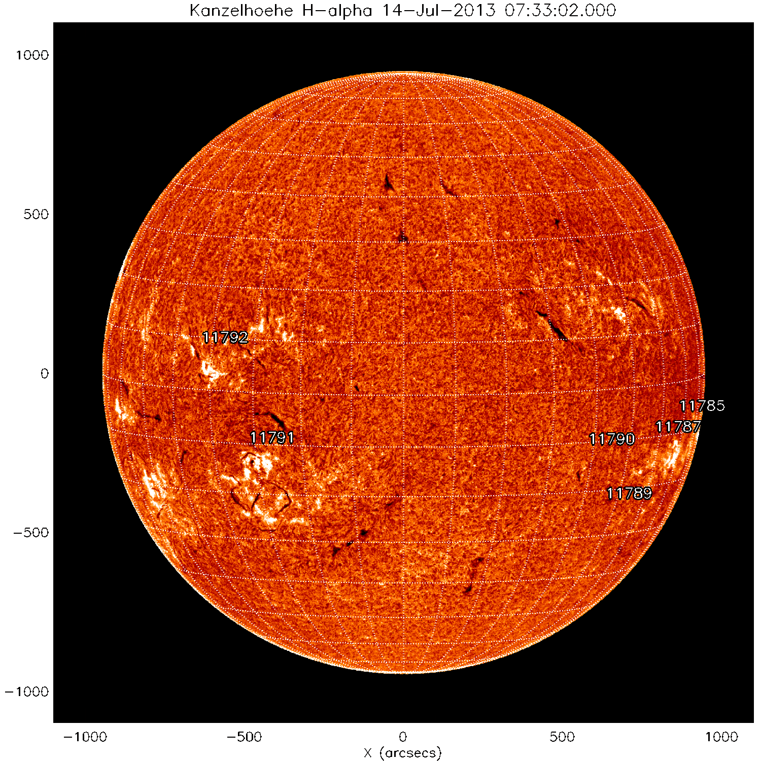
Filaments
Nancay Radioheliograph (432 MHz) Kanzelhoehe H-alpha
14 July 2013
Filaments
solarmonitor.org
solarmonitor.org

Slide 6
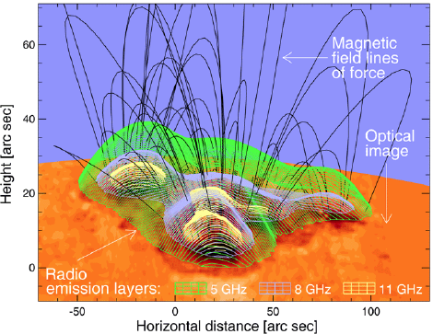
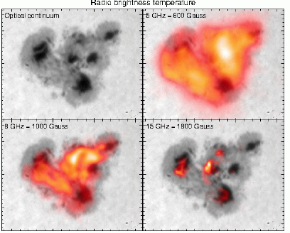
Active Region Magnetic Fields
Microwave emission from gyro-resonance and gyro-synchrotron mechanisms.
Can model magnetic field in corona.
Active region showing strong shear: radio images show high B and very high temperatures
Lee et al. (1998)

Slide 7
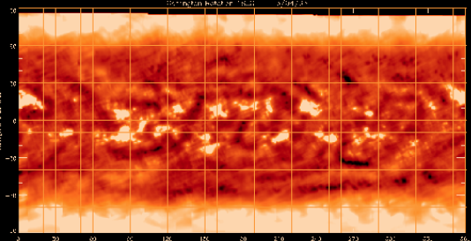
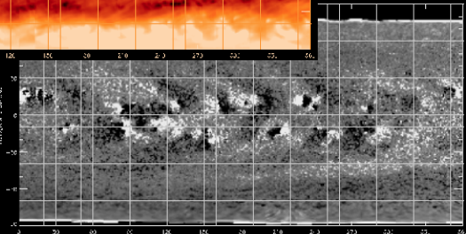
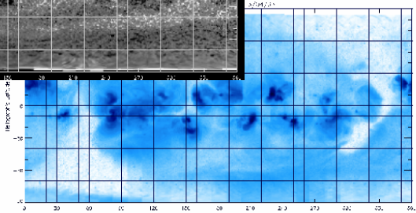
Solar Activity Cycle
17 GHz
Can monitor coronal holes and active regions synoptically – mapping open and closed corona.
Magnetogram
X-ray

Slide 8
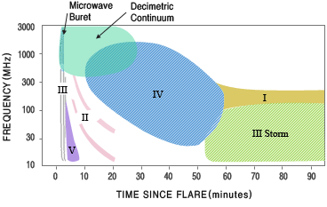
Solar Radio Bursts

Slide 9
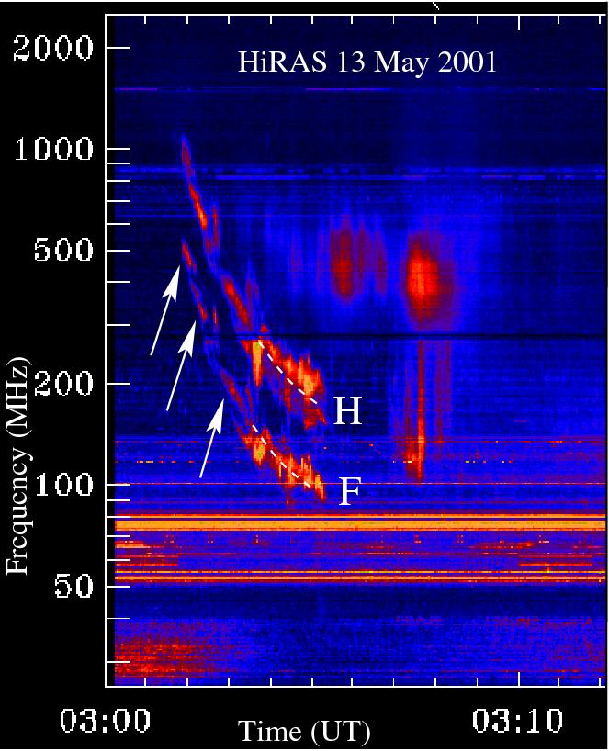
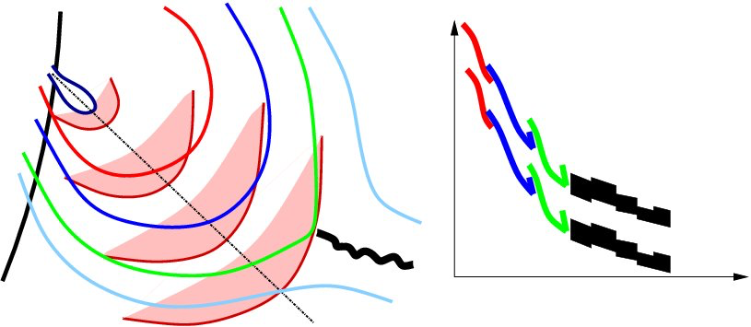
Type II Radio Bursts
Shock-accelerated electrons. Example below shows fragmented radio emission reveals a shock passing through solar active region loops.
CME Front
Frequency
Time
Mancuso & Abbo (2004)

Slide 10
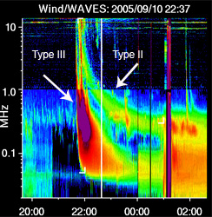
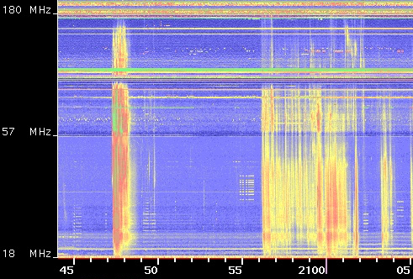
Type III Radio Bursts
Energetic electrons on open magnetic field lines
Fast drift in frequency => ~0.3 speed of light
Gopalswamy et al. (2007)

Slide 11
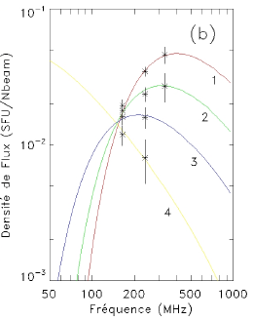
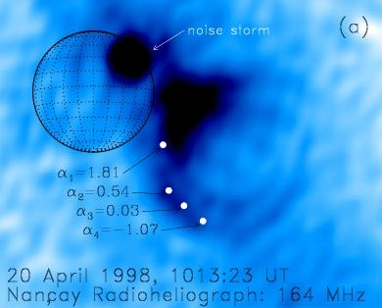
Coronal Mass Ejections
Radio multi-frequency imaging can reveal structure of CMEs their dynamics => important for arrival prediction at 1AU.
Bastian et al. (1998,2001)

Slide 12
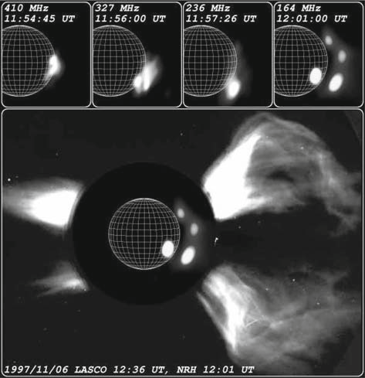
Coronal Mass Ejections
Radio multi-frequency imaging can reveal structure of CMEs their connection to low corona => estimate of propagation direction.
Maia et al. (2001)

Slide 13
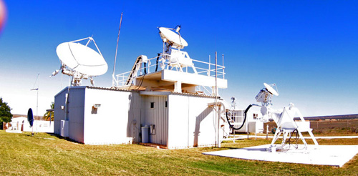
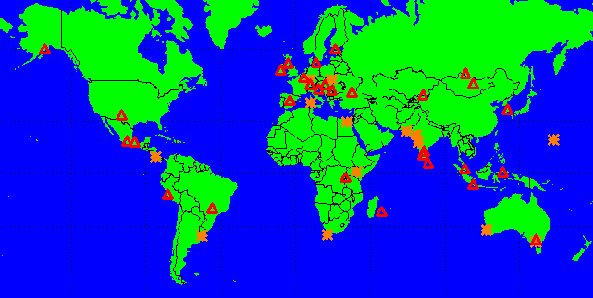
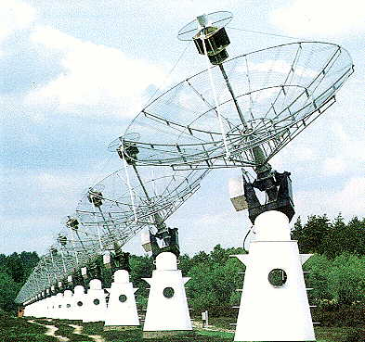
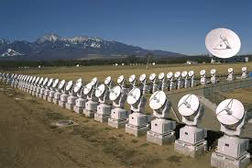
Existing Space Weather-Relevant Observatories
Radio Solar Telescope Network (RSTN)
E-Callisto Network
Australian Space Weather Service
Korean Solar Radio Burst Locator
Nancay Radio Observatory
Nobeyama Radioheliograph
Owens Valley Solar Array
RSTN
E-Callisto
Nancay
Nobeyama

Slide 14
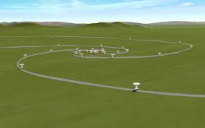
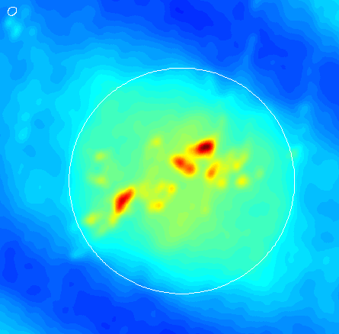
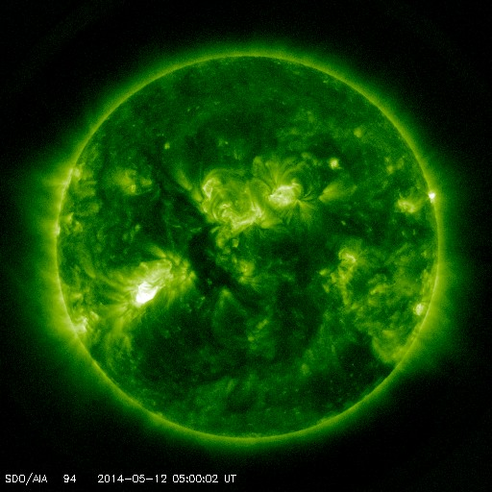
New addition: Chinese Solar Radio Heliograph
Frequency range: 0.4 – 15 GHz
Antennas: 40 x 4.5m and 60 x 2m
Spatial resolution: 1.3 – 50”
Temporal resolution: msec
Polarization: L and R
Field of view: 41” – 11º
CSRH (1.7 GHz) SDO/AIA (171 A)

Slide 15
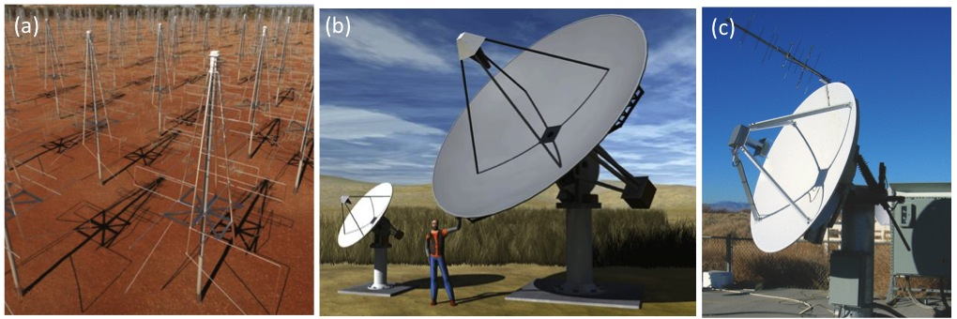
Proposed: European Solar Radio Array (ESOLAR)
Frequency range: ~0.1 – 3 GHz.
Dynamic spectra and imaging.
Radio burst, coronal hole, active region, and filament monitoring.

Slide 16
Issues with Current Radio Observations
Higher sensitivity needed for both imaging and spectral.
Incomplete spectral coverage.
Incomplete 24-7 coverage.
Imaging unavailable at many frequencies.
Difficult to combining different spectrometer data
  => data standards not well adhered to.

Slide 17
Requirements for Space Weather Applications
Requirement: Continuous monitoring of the radio Sun
  Global network operating in realtime.
  EU-US-Australia-India-China-Japan-South Africa?
  Space-based antennae? Nanosats?
Requirement: Dynamic spectra
  Burst type and drift rates/shock velocities.
  Calibrated flux measurements at >1 GHz.
  A SRBL/KSRBL network?
Requirement: Imaging-spectroscopy
  Burst locations on disk.
  Brightness temperatures and magnetic fields.
  Microwave in China and US – missing in Europe => ESOLAR?

Slide 18
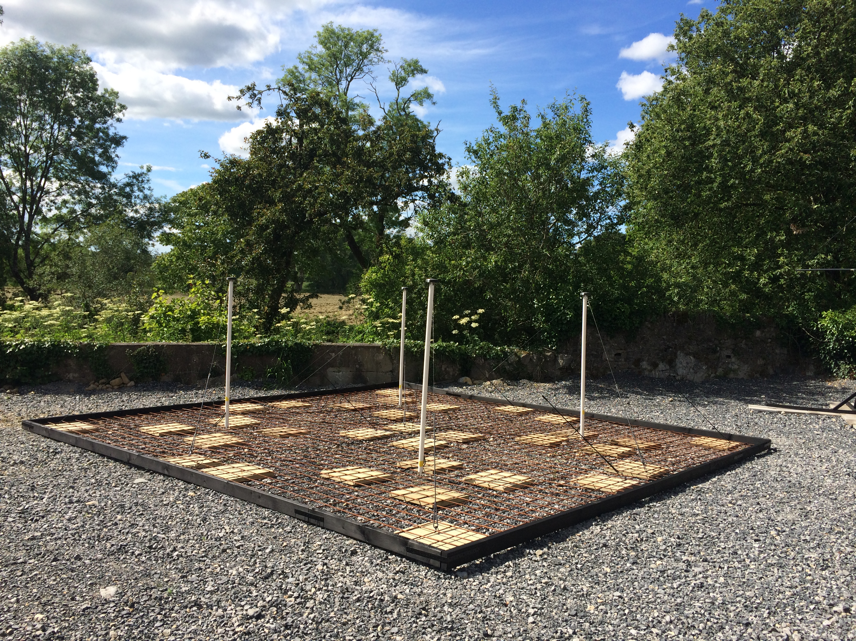
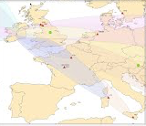
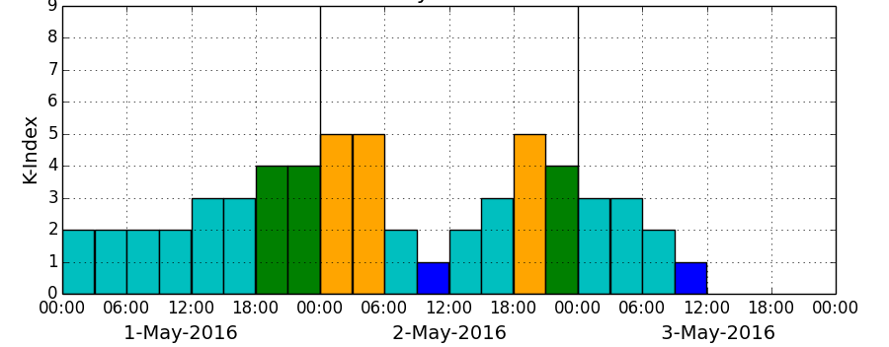
Trinity SW Products – Not currently in ESA-SSA
Callisto Radio Burst Monitoring
www.SolarMonitor.org
VLF Sudden Ionospheric Disturbances
TCD automated algorithms for:
Active regions (SMART; Higgins et al.)
CMEs (CORIMP; Byrne et al.)
Coronal holes (CHARM; Krista & Gallagher)
EUV waves (CorPITA; Long et al.)
Geomagnetic storms and GICs (Blake et al.)
Irish Magnetograph Network

